Slide 1
Edge Detection
The purpose of Edge Detection is to find jumps in the brightness function (of an image) and mark them.

Slide 2
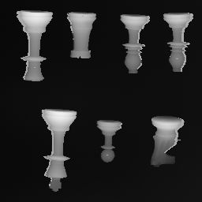
Consider this picture

Slide 3
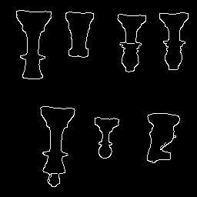
We would like its output to be

Slide 4
Edge Detection
So, to repeat: The purpose of Edge Detection is to find jumps in the brightness function (of an image) and mark them.
Before we get into details, we need to detour
and introduce the concept of Convolution.

Slide 5
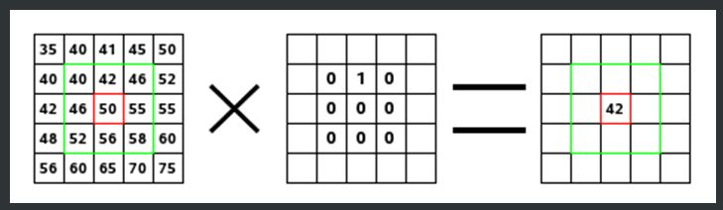

Concept 1: Computing Weighted Sum

Slide 6
Concept 2: Convolution
Is an operation between two tables of numbers,
usually between an image and weights.
Typically, if one table is smaller, it is on the right of the operator
*
[ ] [ ] = ???
Image Weights
*
-1 +1
-2 +2
0 2
1 3

Slide 7
Executing a Convolution
Pad left array with several zeros.
Do a double-flip or diagonal flip on right array.
Then compute the weighted sum.
(In practice we don’t do double flip.)

Slide 8
Convolution: Step One Padding an array with zeros
[ ]
-1 +1
-2 +2
Do we start Convolution at the start of original numbers or from the padded numbers?
0 0 0 0 0 0
0 0 0 0 0 0
0 0 -1 +1 0 0
0 0 -2 +2 0 0
0 0 0 0 0 0
0 0 0 0 0 0

Slide 9
Convolution : Step Two Double Flip the second array
[ ]
0 2
1 3
[ ]
1 3
0 2
[ ]
3 1
2 0

Slide 10
Convolution: Step Three Computing Weighted Sum
In practice, we should have an odd number of rows and columns for
the right table, and the sum will go in the center.

Slide 11
Computing Weighted Sum
The computed sum goes in this location, but not on the original image, instead, it goes on an output table.
0 0 0 0 0 0
0 0 0 0 0 0
0 0 -1 +1 0 0
0 0 -2 +2 0 0
0 0 0 0 0 0
0 0 0 0 0 0
[ ]
3*0 + 1*0 + 2*0 + 0*0
This calculates the
weighted sum.
3 1
2 0
The weights
Summing these numbers after weighting them by the individual weights
[ ]
Note: each weighted sum results in
one number.
This number gets placed in the output
array in the position that the inputs came
from.
0

Slide 12
The previous slide….
Was an example of a one-location convolution.
If we move the location of the numbers being summed, we have scanning convolution.
The next slides show the scanning convolution.

Slide 13
Computing Weighted Sum
First compute all columns in first row, then move on to the second row, and so on.
0 0 0 0 0 0
0 0 0 0 0 0
0 0 -1 +1 0 0
0 0 -2 +2 0 0
0 0 0 0 0 0
0 0 0 0 0 0
[ ]
3 1
2 0
3*0 + 1*0 + 2*0 + 0*0
This calculates the
next weighted sum.
The weights
Summing these numbers
This number gets placed in the output
array in the NEXT position.
[ ]
0 0

Slide 14
Computing Weighted Sum
0 0 0 0 0 0
0 0 0 0 0 0
0 0 -1 +1 0 0
0 0 -2 +2 0 0
0 0 0 0 0 0
0 0 0 0 0 0
[ ]
3 1
2 0
3*2 + 1*0 + 2*0 + 0*0
This calculates the
next weighted sum.
The weights
Summing these numbers
This number gets placed in the output
array in the NEXT position.
[ ]
0 0
6

Slide 15
Computing Weighted Sum
In example, have two arrays of four numbers each
One is the image, the other is the weights.
The result is the weighted sums (the output)
[ ] [ ] = [ ]
-1 +1
-2 +2
*
0 2
1 3
0 -2 +2
-1 -6 +7
-2 -4 +6
(image)
(weights)
(weighted sums)

Slide 16
Edge Detection
Now that we have defined convolution, and
know how to execute it, let us put aside the
concept of Convolution, while we consider
a simple approach to detecting a steep jump in
brightness values in a row.
(After that, we will employ the notion of
convolution).

Slide 17
Consider this picture

Slide 18
Consider a row of values in picture
1 2 1 0 98 99 98 97 99 98 1 2 1 2
Look at: abs(jumps in value sideways)

Slide 19
Edge Detection
Create the algorithm in pseudocode:
while row not ended // keep scanning until end of row
select the next A and B pair, which are neighboring pixels.
diff = B – A //formula to show math
if abs(diff) > Threshold //(THR)
mark as edge
Above is a simple solution to detecting the differences in pixel values
that are side by side.

Slide 20
Edge Detection: One-location Convolution
diff = B – A is the same as:
A
B
*
-1
+1
Box 1
Box 2 (“weights”)
Convolution symbol
Place box 2 on top of box 1, multiply.
-1 * A and +1 * B
Result is –A + B which is the same as
B – A

Slide 21
Edge Detection
Create the algorithm in pseudocode:
while row not ended // keep scanning until end of row
select the next A and B pair
diff = //formula to show math
if abs(diff) > Threshold //(THR)
mark as edge
A
B
*
-1
+1
Above is a simple solution to detecting the differences in pixel values
that are side by side.

Slide 22
Edge Detection
Create the algorithm in pseudocode:
while row not ended // keep scanning until end of row
select the next A and B pair
diff = //formula to show math
if abs(diff) > Threshold //(THR)
mark as edge
A
B
*
-1
+1
Note that in this algorithm, we are actually
doing a scanning convolution, the scan
is hidden in the while loop

Slide 23
Edge Detection: Pixel Values Become Gradient Values
2 pixel values are derived from two measurements
Horizontal
Vertical
A
B
*
-1
+1
Note: A,B pixel pair will be moved over
whole image to get different answers at
different positions on the image
A
-1
*
B
+1

Slide 24
The Resulting Vectors
Two values are then considered vectors
The vector is a pair of numbers:
[Horizontal answer, Vertical answer]
This pair of numbers can also be represented by magnitude and direction
Notes:
Maybe students have seen this before in Math class. Geometry or Alg I.

